Slide 1








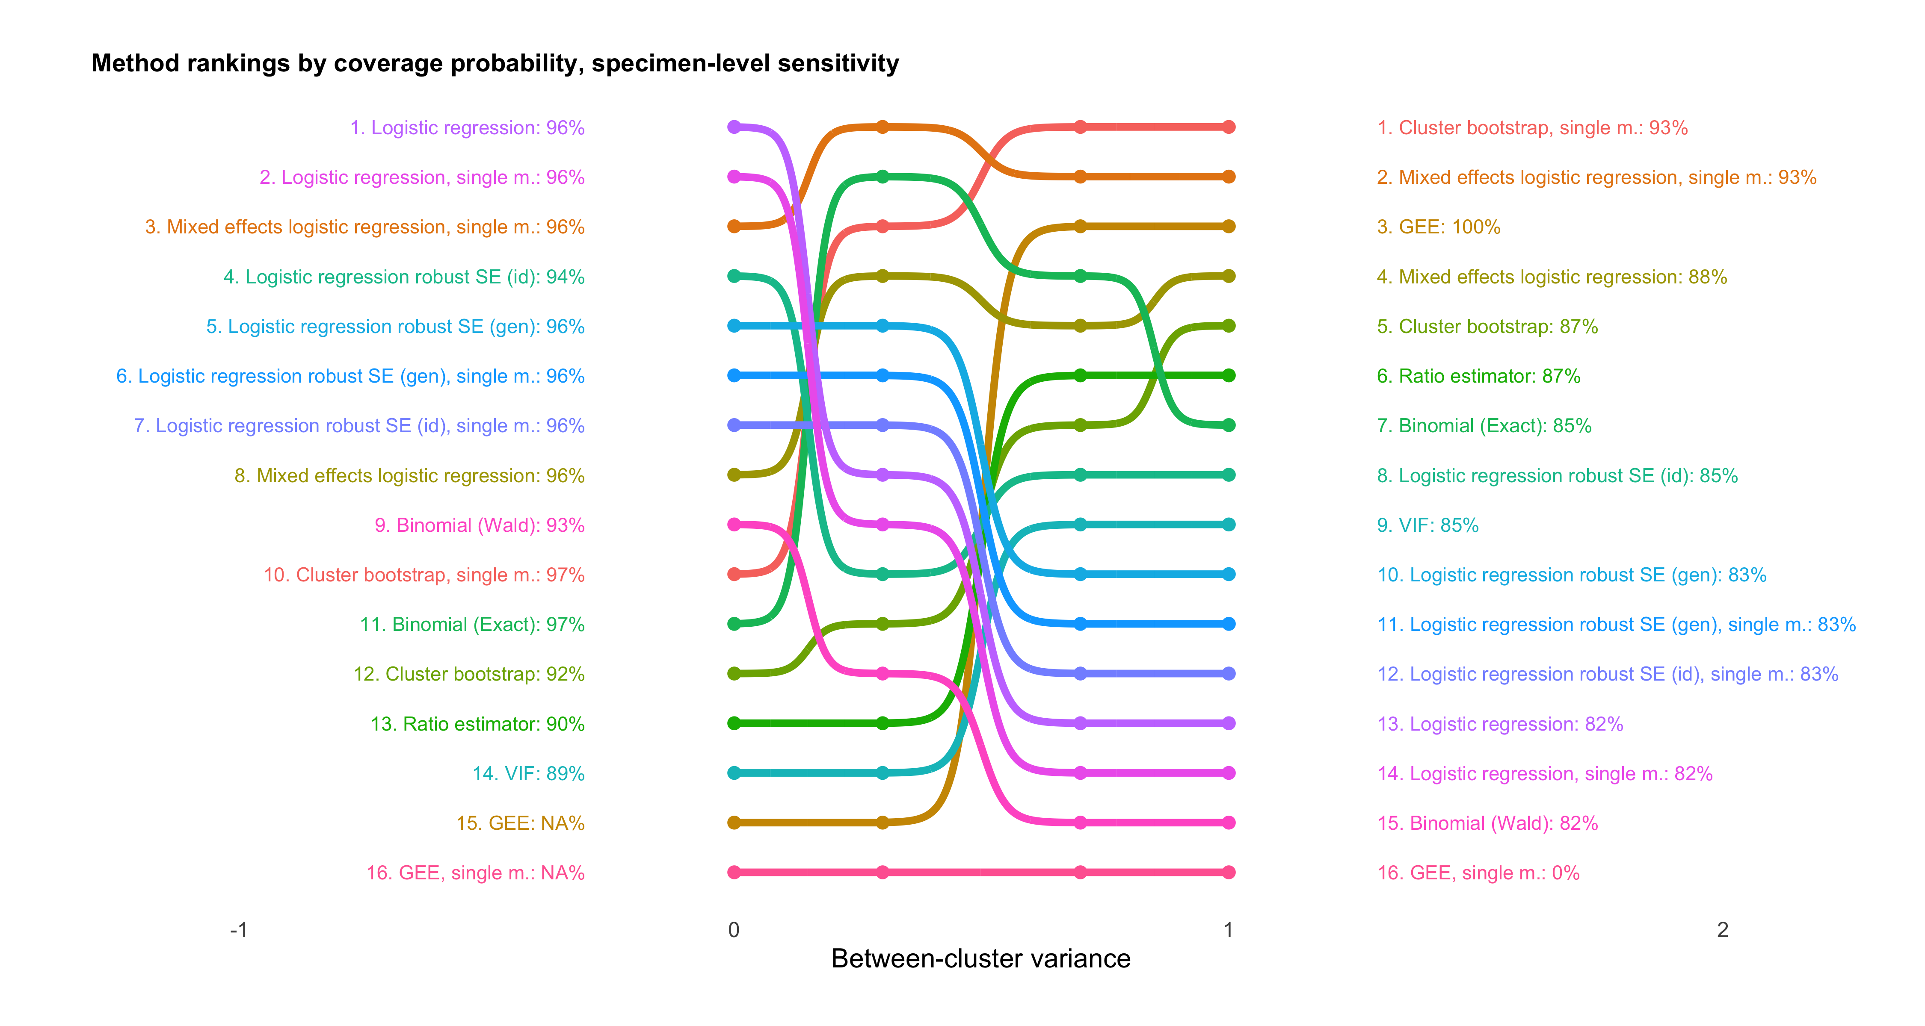
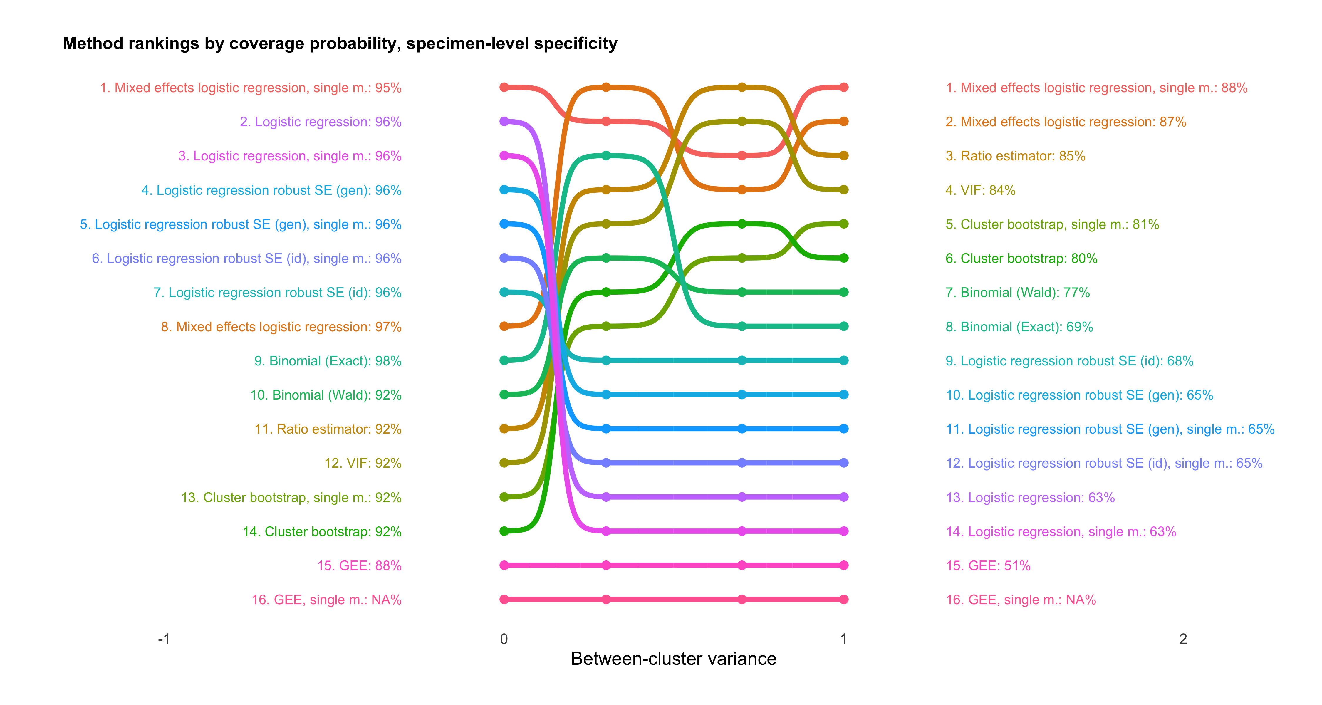
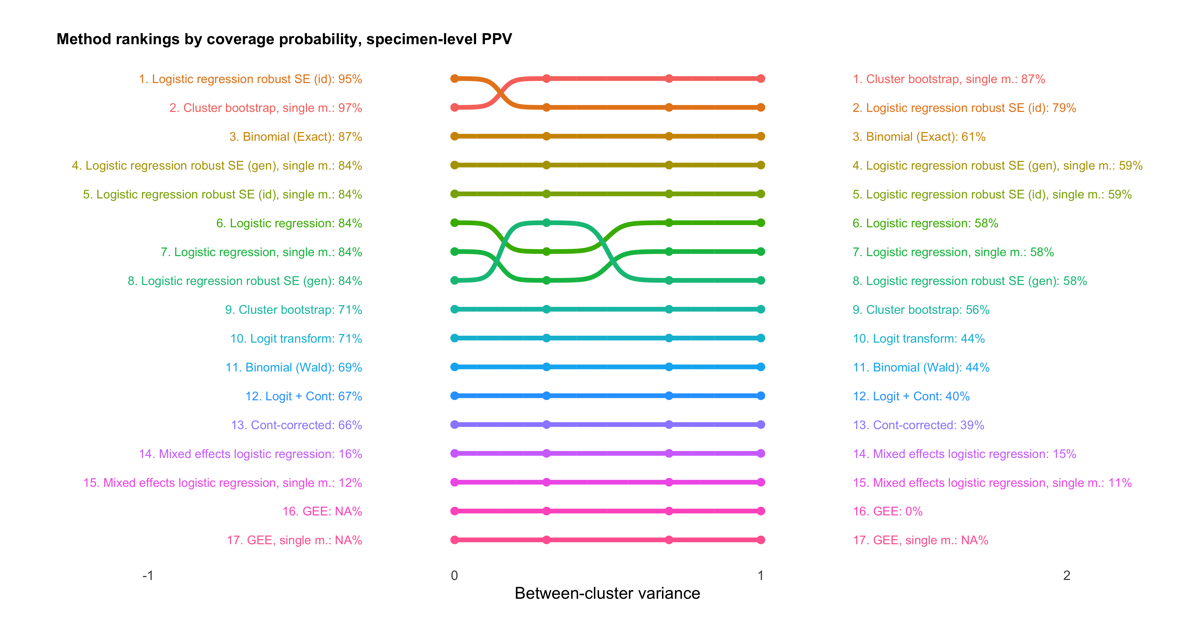
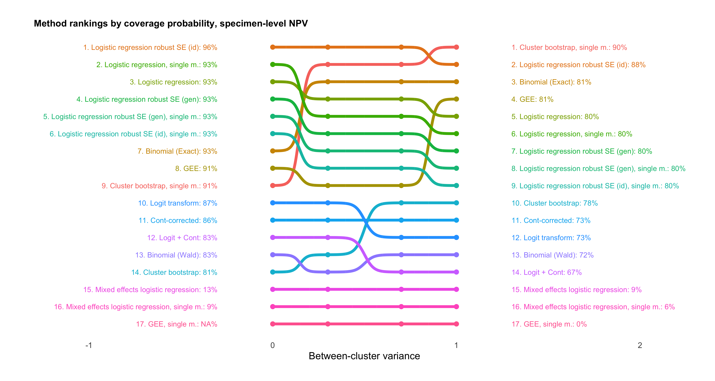
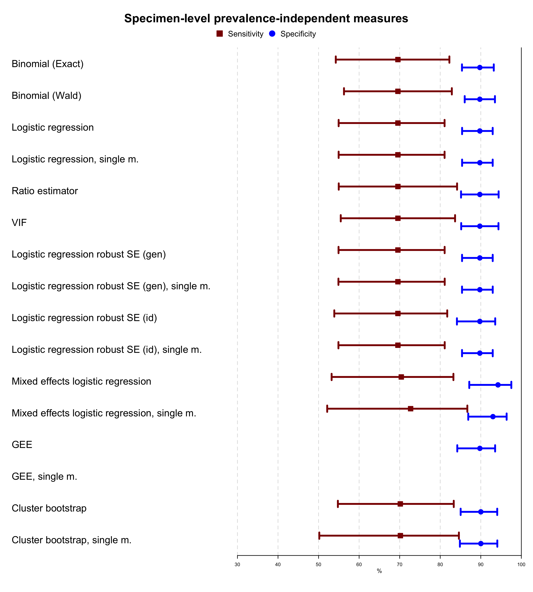

Calculating diagnostic test characteristics in clustered data:
A simulation study
Katalin Tamási, PhD and Gerton Lunter, PhD
Unit of Medical Statistics and Decision Making
Department of Epidemiology, University Medical Center Groningen
tamasi.k@umcg.nl, g.a.lunter@umcg.nl
Introduction
Why do we need to be aware of clustering?
Take-home message
20 independent patients
20 independent patients,
10 specimens each
200 independent patients
What level to analyze your clustered data?
Patient-level analyses:
Appropriate if intervention / clinical consequence is patient-level (e.g., chemo- vs. immunotherapy?)
Clustering is not a concern if patients are independent
Specimen-level analyses:
Appropriate if intervention / clinical consequence is specimen-level (e.g., stent placement vs. angioplasty?)
If clustering is present, adjusting for it yields more valid (= wider) CIs vs. naïve methods
Which method(s) deal best with clustering?
No across-the-board winner but several sensible approaches emerged:
Cluster bootstrap performs consistently well in diverse configurations, works off-the-shelf
Mixed effects models may need tweaking to perform decently
Logistic regression models perform adequately only with robust SEs and when diseased vs. non-diseased populations are separated
GEEs are only valid with large samples
Given your data, our open-access R script outputs
Contingency tables at each level of analysis
Degree of clustering (ICC) in diseased and healthy populations
Summary tables of diagnostic test value and CIs using every method
Forest plots of each diagnostic test value and CIs using every method
So you can make an informed choice based on your unique circumstances
≠
≠
 |  | Disease status
 |  | + | − | Total
Test status | + | 8 | 1 | 9
 | − | 2 | 9 | 11
 | Total | 10 | 10 | 20
 |  | Disease status
 |  | + | − | Total
Test status | + | 80 | 10 | 90
 | − | 20 | 90 | 110
 | Total | 100 | 100 | 200
 |  | Disease status
 |  | + | − | Total
Test status | + | 80 | 10 | 90
 | − | 20 | 90 | 110
 | Total | 100 | 100 | 200
Sensitivity: 80% (44 to 97%) Specificity: 90% (56 to 100%)
Sensitivity: 80% (somewhere in between) Specificity: 90% (somewhere in between)
Sensitivity: 80% (71 to 87%) Specificity: 90% (82 to 95%)
Clustering introduces multiple levels of analysis (patient-level, specimen-level, etc.)
Higher degree of clustering → Less information encoded → Less certainty in the estimates
Clustering is ubiquitous ⬄ Routinely ignored in medical literature, possibly because there is no straightforward way to adjust for it → We developed an R script to provide a one-stop-shop solution
Method
Parameter space: plausible & at cases extreme values to assess robustness
SETUP
Patient-level
disease prevalence
Disease status_{i}
Parameters | Config 1 | Config 2 | Config 3 | Config 4
Population size | 30 | 60 | 100 | 200
Patient-level disease prevalence | 0.1 | 0.2 | 0.4 | 0.5
Number of specimens per patient | 3 | 5 | 10 | 20
Specimen-level disease prevalence | 0.9 | 0.6 | 0.3 | 0.1
Specimen-level sensitivity | 0.6 | 0.8 | 0.9 | 0.95
Specimen-level specificity | 0.95 | 0.9 | 0.85 | 0.7
Number of clusters | 20 | 10 | 5 | 3
Degree of clustering manipulated by Between-cluster variance | 0 →1 | 0 →1 | 0 →1 | 0 →1
We simulated a large number (5000) of patient samples given each of the 4 configurations
Within each sample: Calculated each diagnostic test value + 95% CI using each method
Evaluated methods based on
Coverage probability: the closer to the nominal 95% the better
CI length: the narrower the better
Assessed robustness of performance as degree of clustering ↑
Specimen-level
disease prevalence
Specimen status_{ij}
Specimen-level
sensitivity & specificity
Test status_{ij}
Specimens (j)
Patients (i)
Results
As degree of clustering ↑ (x-axis):
Coverage probabilities systematically decline
Adjusting methods outperform naïve ones
Relative rankings (but not coverage probabilities) remain stable across configurations (only Config 2 shown →)
Comparable coverage probabilities with only 1000 samples (max difference: ± 3 %)
Performance remains closest to nominal across diagnostic test values with single model of cluster bootstrap
Mixed effects models only perform well when the approximation of the integral over random effects is decent → May need to change no. of quadrature points / optimizer to obtain better approximation
Logistic regression models only reliable when robust SEs are adjusted by cluster and diseased vs. non-diseased populations separated (→ separate ICCs)
GEEs don’t reliably converge in small samples (<5 patients per any cell in contingency table)
Other variance adjustment methods decent but not superior to cluster bootstrap or regression methods
Discussion
Acknowledgments
We aim to give clinicians the tools to:
Determine if clustering is an issue
Specimen-level analysis is indicated & ICC > 0
Choose the optimal approach given needs & constraints
Cluster bootstrap: most versatile choice
Mixed effects models: default parameters may be suboptimal
Logistic regression models: robust SE separate model outperforms the others
GEEs: only work with large samples (≥5 in contingency table)
Minimize error & bias when designing diagnostic studies
Properly interpret merits and limitations of published findings
R script output
Degree of clustering (ICC) in diseased and healthy populations
Summary tables of each diagnostic test value & CIs
Forest plots of each diagnostic test value & CIs (example →)
Contingency tables at each level of analysis
We thank our department members and Dieuwke Broekstra for discussions and feedback and the Center for Information Technology of the University of Groningen for providing access to the Peregrine high performance computing cluster.
More information including the complete R code, graphs, and references can be found at http://github.com/KataTam/DiagTestCluster.

